Slide 1
GAMSPy:
A Pipeline Friendly General
Algebraic Modeling Language
Adam Christensen
Muhammet Soyturk
Steven Dirkse
Michael Bussieck

Slide 2


Use GAMSPy in your academic life?
Submit creative code to academic@gams.com
Win an iPad!
Deadline - April 1, 2025
Award - May 15, 2025

Slide 3
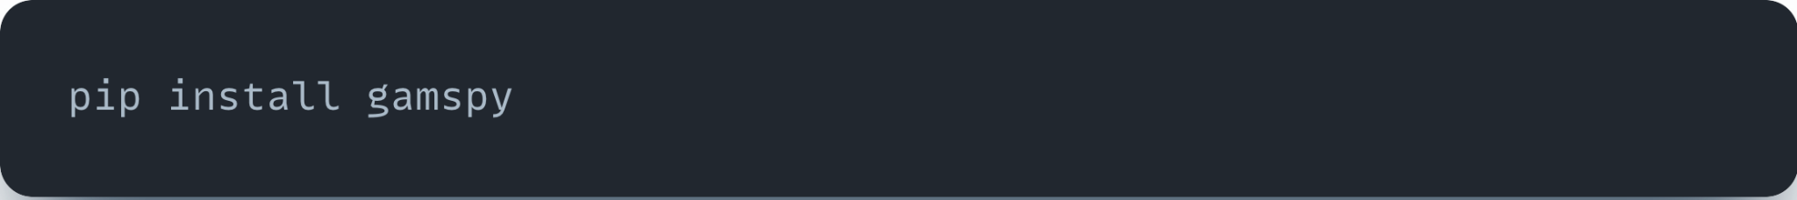
Gimme GAMSPy!
Stable version released
Documentation: gamspy.readthedocs.io
Model library (100+ models): https://github.com/GAMS-dev/gamspy-examples

Slide 4







The GAMS Ecosystem
Modeling Platform
Platform Independent Algebraic Modeling Language
Commercial and Academic Solvers
APIs for major programming languages
Graphical UI Generator
Turns models into web applications
Extendable with custom code
Local or Server Installation
Mathematical Modeling in Python
Uncompromised performance
Seamless pipeline management
Deployment Solution
Solves GAMS models on centralized resources
(on-prem or cloud)
REST API Management
GAMS job scheduling &
Load balancing
Gateway
REST API
3
2
1

Slide 5

The GAMS Ecosystem

Slide 6

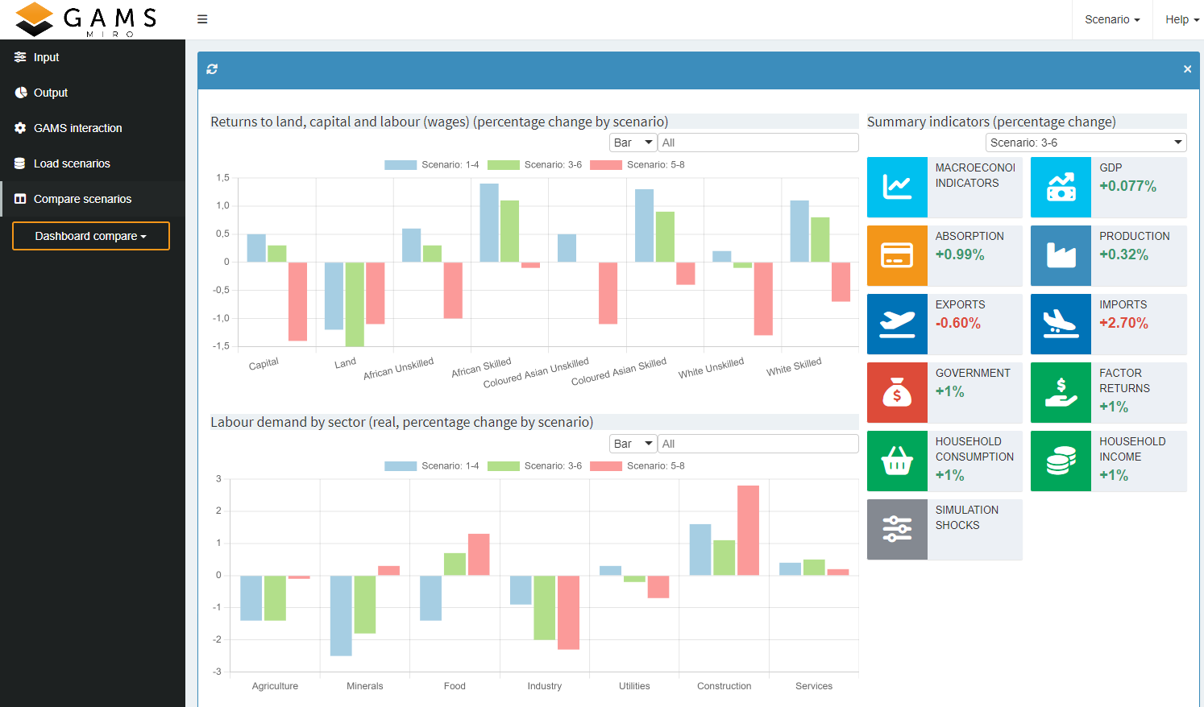
Solving Complex Problems
… not all about the model
Data cleaning
Data manipulation
Data visualization

Slide 7
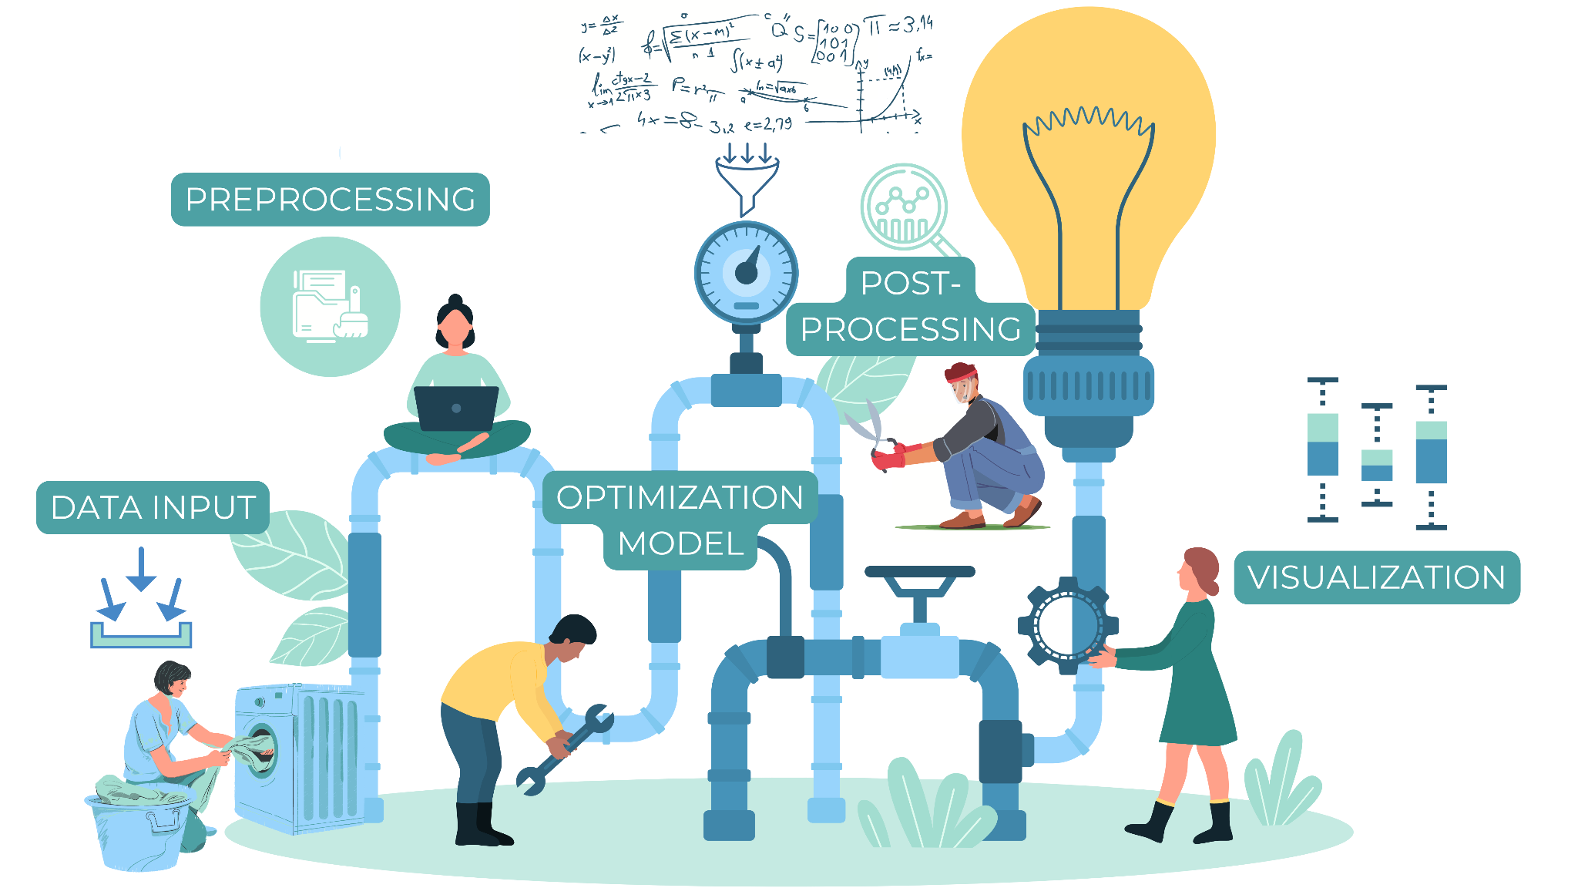





Optimization Pipeline

Slide 8

Python is…
… very popular

Slide 9
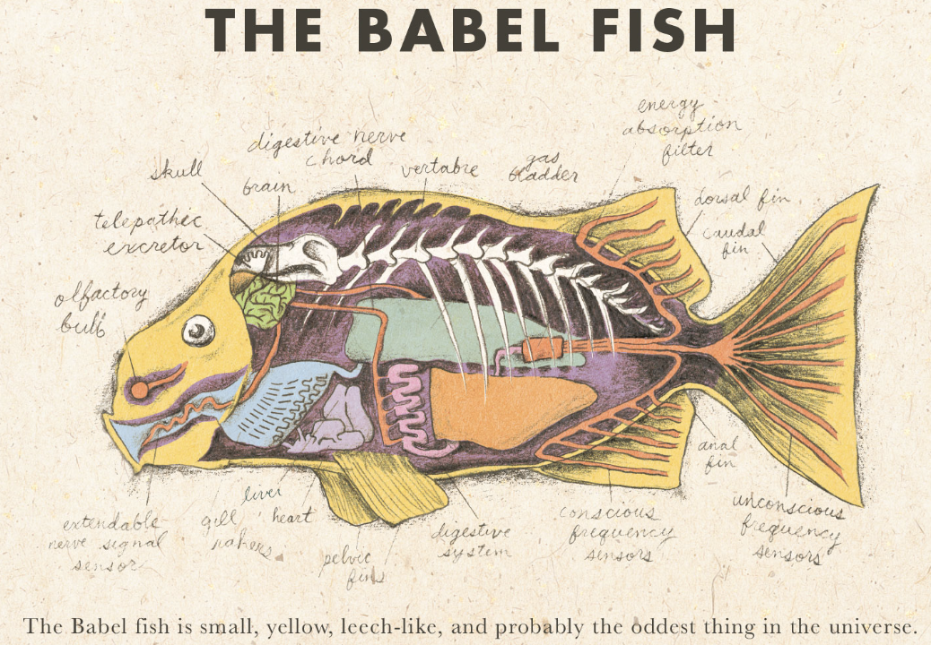


Python is…
… very popular
… a universal translator
… extendable & customizable
… performant (if careful)

Slide 10
5 Core Principles…
Abstract/data-independent modeling
  Records can belong to symbols, but do not define them
Conveniently handle sparse data
  Algebraic syntax is paramount
Convenient and efficient data structures
  Pandas/Numpy are the data backbone
Performant
  Runs with a specialized engine (GAMS)
Interoperable
  Harmony with other GAMS tools

Slide 11
5 Core Principles…
Abstract/data-independent modeling
  Records can belong to symbols, but do not define them
Conveniently handle sparse data
  Algebraic syntax is paramount
Convenient and efficient data structures
  Pandas/Numpy are the data backbone
Performant
  Runs with a specialized engine (GAMS)
Interoperable
  Harmony with other GAMS tools

Slide 12
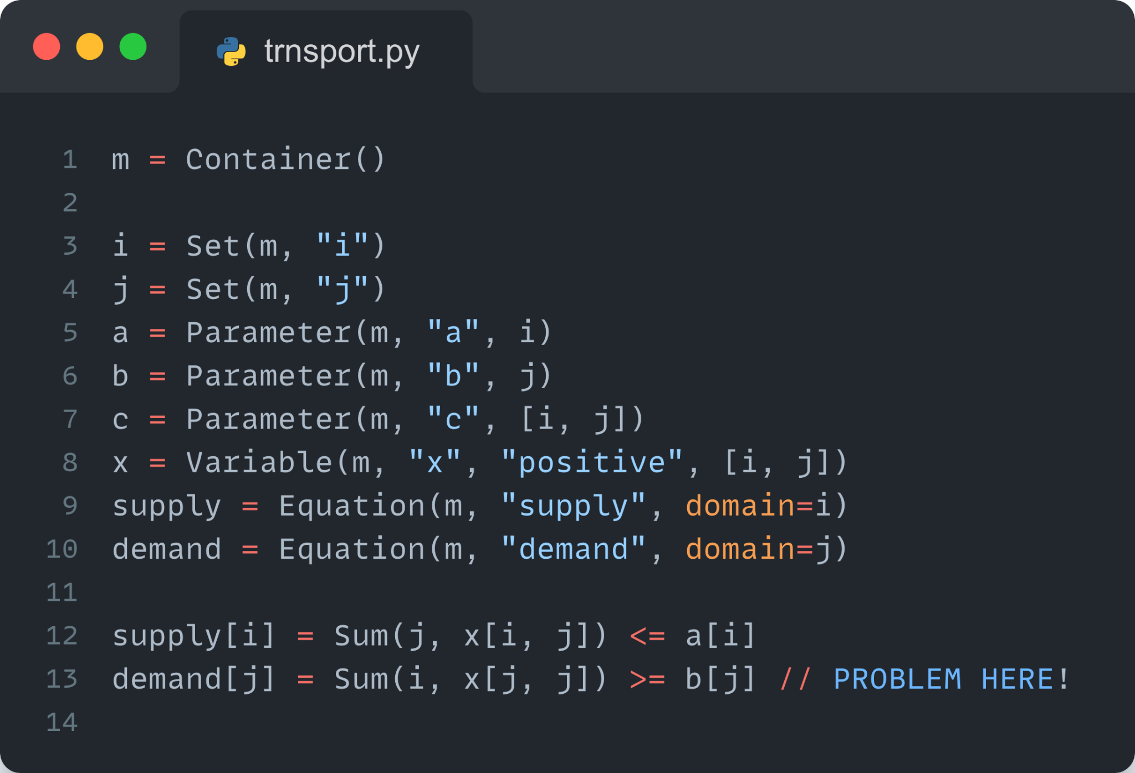
GAMSPy First Look
Abstract Model
Declared/defined over sets
Like “writing on paper”
Compact
Logically consistent (no domain violations, uncontrolled sets)
Completely abstract (no data)
Leverages operator overloading

Slide 13
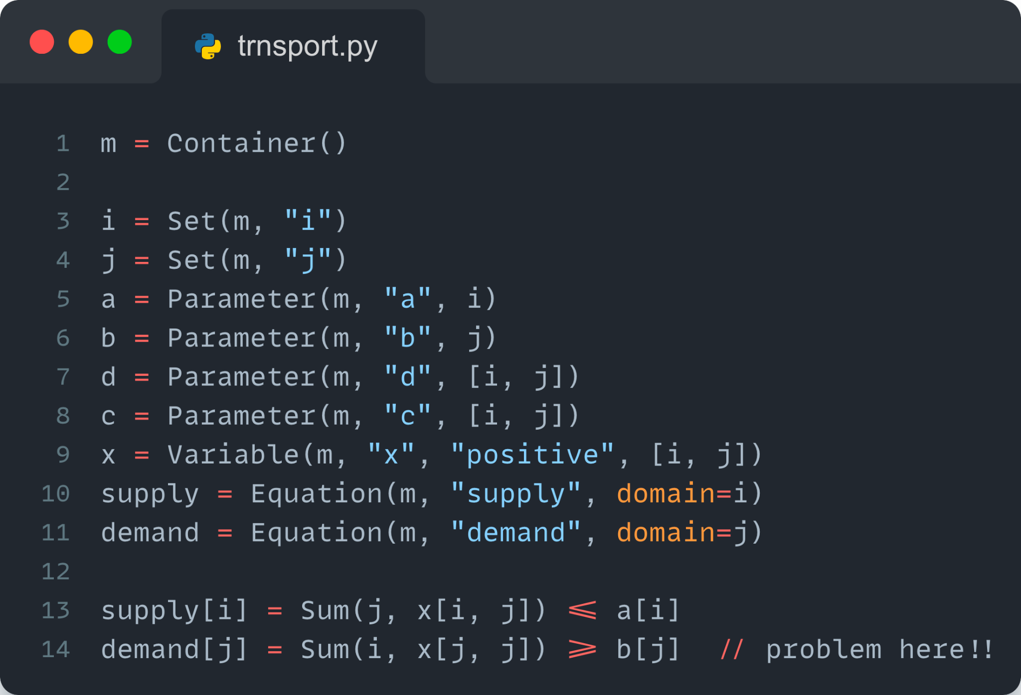
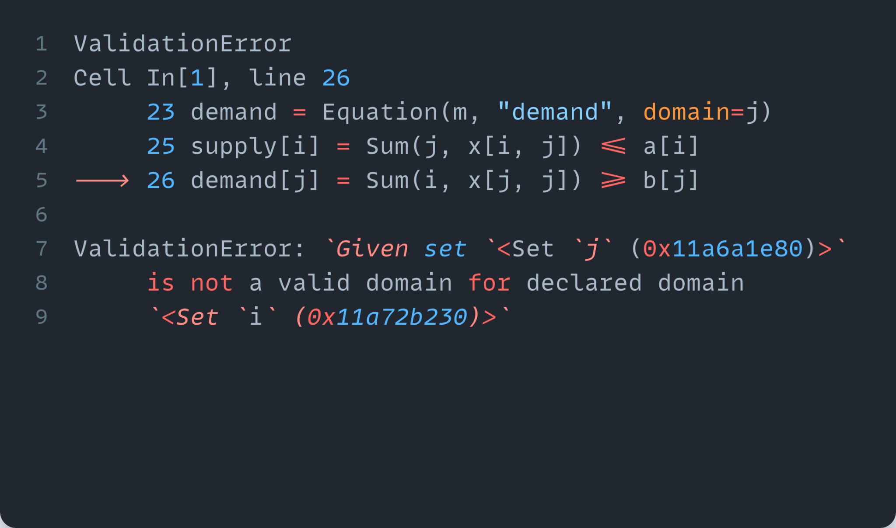
GAMSPy First Look
Generates Early Warnings
Domain violation exists
Cannot create equation block
Raises helpful error messages
GAMS Philosophy - tight syntax leads to better modeling

Slide 14
Conditional Indexing
Core of GAMS syntax
# Nested/Logical Chains
term $ (logical_condition1 $ (logical_condition2$(...)))
term $ (logical_condition1 and logical_condition2 and ...)
# Left hand side
rho(i) $ (sig(i) <> 0) = (1./sig(i)) - 1;
# Right hand side
a = 2 $ (b > 1.5);
# Within Equations
sb(i).. sum(j $ ij(i,j), x(i,j)) =l= s(i);
# Over Domain of Definition
gple(w,wp,te) $ ple(w,wp).. yw(w,te) - yw(wp,te) =l= dpack;

Slide 15
Conditional Indexing
Core of GAMS syntax
# Nested/Logical Chains
term.where[logical_condition1.where[logical_condition2.where[...]]]
term.where[logical_condition1 & logical_condition2 & ...]
# Left hand side
rho[i].where[sig[i]] = (1/sig[i]) - 1
# Right hand side
a = Number(2).where[b > 1.5]
# Within Equations
sb[i] = gp.Sum(j.where[ij[i,j]], x[i,j]) <= s[i]
# Over Domain of Definition
gple[w,wp,te].where[ple[w,wp]] = yw[w,te] - yw[wp,te] <= dpack
Same principles apply in GAMSPy

Slide 16
Specialized Operators
Sum (not sum)
etc…
# GAMS assignment
b = Sum((i,j)$(sameAs(i,j)), 1)
# GAMSPy assignment
b = gp.Parameter(m, “b”)
b[...] = gp.Sum(gp.Domain(i,j).where[i.sameAs(j)], 1)

Slide 17
Specialized Math
Max (not max)
etc…
from gamspy import Container, Set, Parameter
from gamspy.math import Max
m = Container()
i = Set(m, name="i", records=["i1", "i2", "i3"])
a = Parameter(m, "a", domain=i, records=[("i1", 2), ("i2", 0.3), ("i3", 2.5)])
b = Parameter(m, "b", domain=i)
b[i] = Max(a[i], 1)

Slide 18
Model Object
Aware of Container but does not live in a Container
magic = gp.Model(
m,
equations=m.getEquations(),
problem="MIP",
sense="min",
objective=z,
)
magic.solve(solver="cplex")
Model instance generated at .solve()
Frozen solves are easy with .freeze()/.unfreeze()

Slide 19
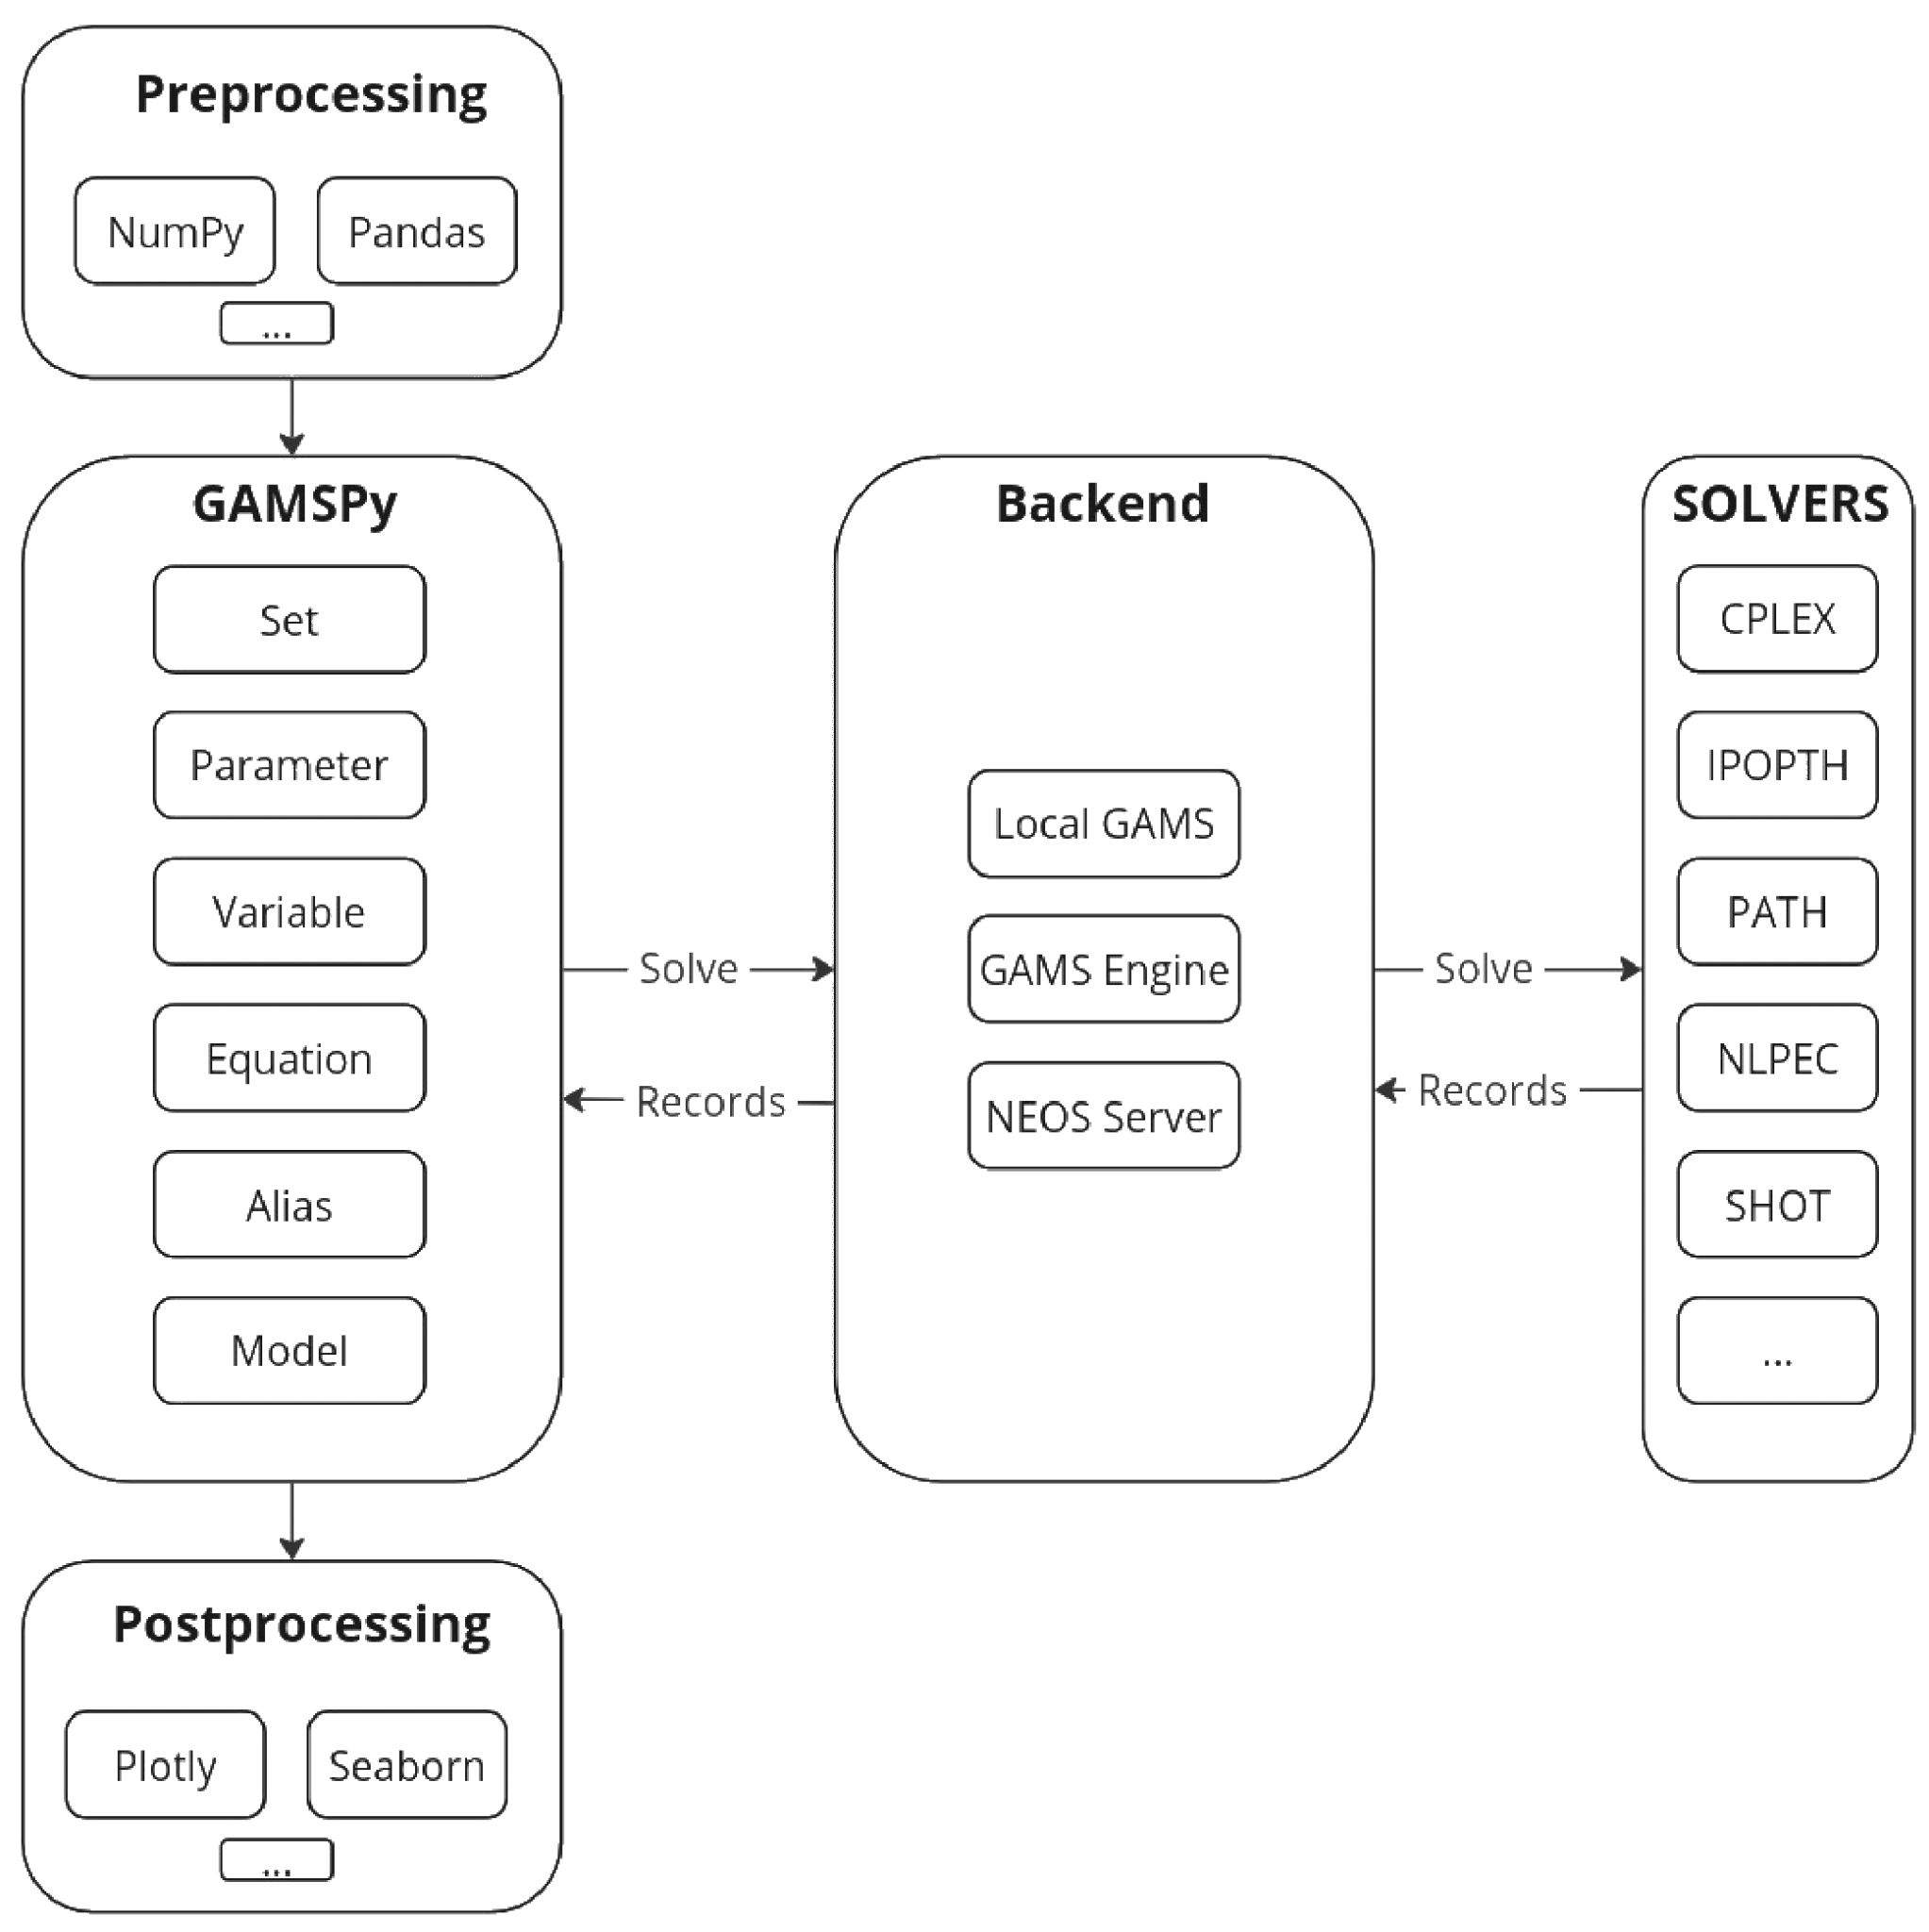
GAMSPy Process Flow
GAMS lives as a separate process behind the scenes
Multiple Containers will spawn multiple GAMS processes
Container changes trigger synch w/ GAMS
Moves data in bulk

Slide 20
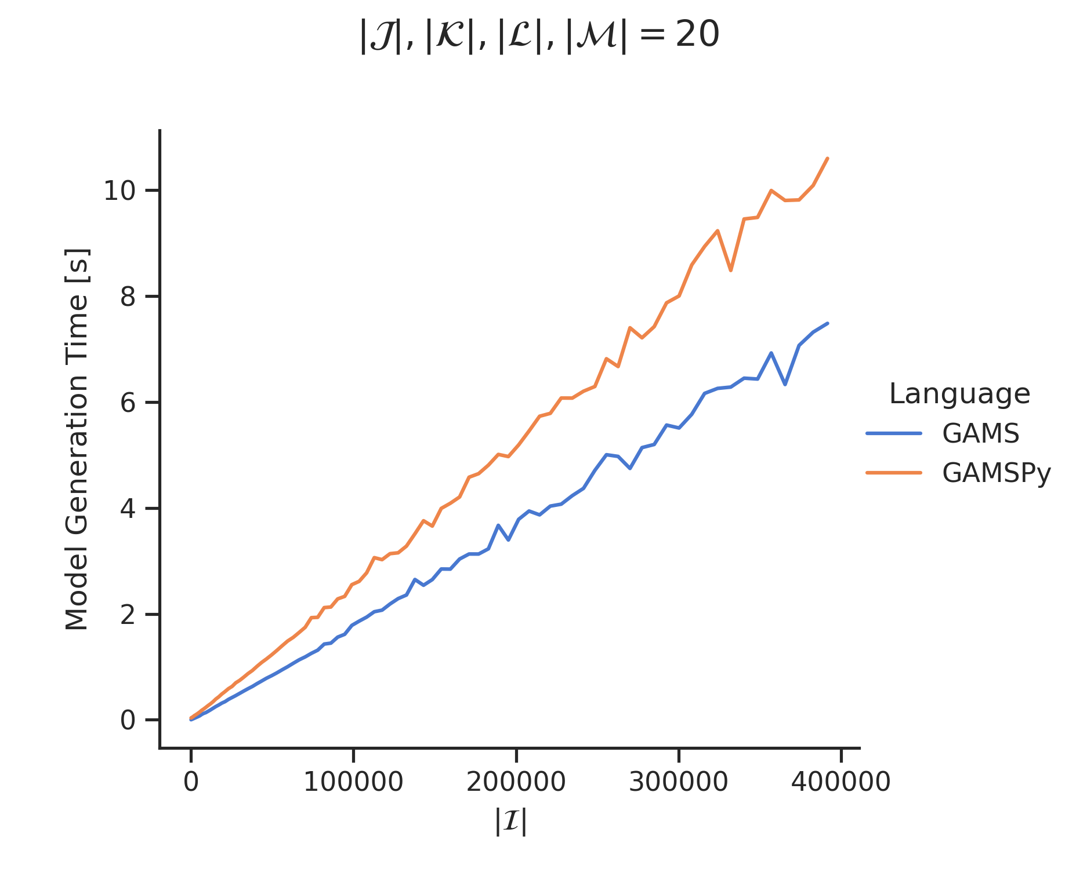

Why GAMSPy? - Performance
blog post for more details

Slide 21
Summary
Generates mathematical models (not instances) – pure representation of mathematical symbols, devoid of specific data
GAMSPy leverages a GAMS backend to execute assignment operations, generate and solve models
Access a broad set of state-of-the-art optimization solvers
Unique and streamlined way to completely tasks like pre/post-processing and visualization – all in a single environment
GAMSPy works seamlessly with GAMS MIRO, GAMS Engine, and NEOS (local machines vs. cloud/AWS machines)
GAMSPy is fully installable with one line – pip install gamspy

Slide 23
Indexed Operations
Sum (not sum)
More complex objects (Domain)
# GAMS assignment
b = Sum((i,j)$(sameAs(i,j)), 1)
# GAMSPy assignment
b = gp.Parameter(m, “b”)
b[...] = gp.Sum(gp.Domain(i,j).where[i.sameAs(j)], 1)
[...] - saves the python object

Slide 24
Indexed Operations
Sum (not sum)
More complex objects (Domain)
# GAMS assignment
b = Sum((i,j)$(sameAs(i,j)), 1)
# GAMSPy assignment
b = gp.Parameter(m, “b”)
b[...] = gp.Sum(gp.Domain(i,j).where[i.sameAs(j)], 1)
[...] - saves the python object
gp.Sum - special GAMS Sum that is aware of GAMSPy symbols

Slide 25
Indexed Operations
Sum (not sum)
More complex objects (Domain)
# GAMS assignment
b = Sum((i,j)$(sameAs(i,j)), 1)
# GAMSPy assignment
b = gp.Parameter(m, “b”)
b[...] = gp.Sum(gp.Domain(i,j).where[i.sameAs(j)], 1)
[...] - saves the python object
gp.Sum - special GAMS Sum that is aware of GAMSPy symbols
gp.Domain - exposes .where method (and others)

Slide 26
Indexing & Slicing
Easy to initialize symbols
m = gp.Container()
i = gp.Set(m, "i", records=list("abc"))
j = gp.Set(m, "j", records=list("def"))
d = gp.Parameter(m, name="d", domain=[i, j])
c = gp.Parameter(m, name="c", domain=[i, j])
d[...] = 1
c[i, j] = 90 * d[i, j] / 1000
print(d.records)
i j value
0 a d 1.0
1 a e 1.0
2 a f 1.0
…
print(c.records)
i j value
0 a d 0.09
1 a e 0.09
2 a f 0.09
…

Slide 27
Indexing & Slicing w/ Conditionals
Easy to initialize symbols
m = gp.Container()
i = gp.Set(m, "i", records=list("abc"))
j = gp.Set(m, "j", records=list("def"))
d = gp.Parameter(m, name="d", domain=[i, j])
c = gp.Parameter(m, name="c", domain=[i, j])
d[...] = 1
c[i["b"], j] = 90 * d[i, j] / 1000
# or
c[i, j].where[i.sameAs("b")] = 90 * d[i, j] / 1000
print(d.records)
i j value
0 a d 1.0
1 a e 1.0
2 a f 1.0
…
print(c.records)
i j value
0 b d 0.09
1 b e 0.09
2 b f 0.09

Slide 28
Setting GAMS Solve Options
Options → passed in .solve()
from gamspy import Container, Variable, Equation, Model, Sense, Problem, Options
m = Container()
# < Model Algebra and Data >
# < Define Model w/ equations >
model = Model(
m,
equations=m.getEquations(),
problem=Problem.LP,
sense=Sense.Max,
objective=z,
)
model.solve(options=Options(iteration_limit=2))

Slide 29
Setting Solver Options
Dict structure (specific to solvers)
from gamspy import Container, Variable, Equation, Model, Sense, Problem, Options
m = Container()
# < Model Algebra and Data >
# < Define Model w/ equations >
model = Model(
m,
equations=m.getEquations(),
problem=Problem.LP,
sense=Sense.Max,
objective=z,
)
model.solve(options=Options(iteration_limit=2), solver_options={"rtmaxv": "1.e12"})

Slide 30
Functions as Macros
# GAMS
$macro reciprocal(y) 1/y
scalar z, x1 /2/, x2 /3/;
z = reciprocal(x1) + reciprocal(x2);
display z;
# GAMSPy
def reciprocal(y):
return 1 / y
m = gp.Container()
z = gp.Parameter(m, "z")
x1 = gp.Parameter(m, "x1", records=2)
x2 = gp.Parameter(m, "x2", records=3)
z[:] = reciprocal(x1) + reciprocal(x2)
print(z.records)

Slide 31

GAMSPy – Under the Hood
GAMS lives as a separate process behind the scenes
Multiple Containers will spawn multiple GAMS processes
Every time the Container changes the changes are synch’d with GAMS
GAMSPy is tuned to move data in bulk, merge operations are expensive
There can be performance implications

Slide 32
Selective Synchronization
import gamspy as gp
m = gp.Container()
i = gp.Set(m, "i", records=range(1000))
f = gp.Parameter(m, domain=i)
f["0"] = 0
f["1"] = 1
f.synchronize = False
for n in range(2, 1000):
f[str(n)] = f[str(n - 2)] + f[str(n - 1)]
f.synchronize = True

Slide 33
Selective Loading on Solve
import gamspy as gp
m = gp.Container()
# model here
model.solve(load_symbols=[x])

Slide 34
Debugging
Can access all GAMS-like files (gms, lst, log, etc…)
Specify working_directory
from gamspy import Container
m = Container(working_directory=".")
# < Model >
model.solve()

Slide 35
Custom Object Creation = Convenience
Symbols hold references to other symbols
What if a Symbol changes? → GT can overwrite!
m = gt.Container()
i = gt.Set(m, "i", records=list("abc"))
j = gt.Set(m, "j", i, records=list("ab"))
# j hold a reference to i
print(id(i) == id(j.domain[0]))
True
# call constructor -> j still has valid link to i
i = gt.Set(m, "i", records=list("abcdef"))
print(id(i) == id(j.domain[0]))
True
Why is this helpful?
Jupyter environments
  constantly running cells out of “order”
Maintains links for consistent Container
Helps flatten the learning curve

